Slide 1
Accounting for asymmetry and batch effects in meta-transcriptomics
Greg Gloor
U. Western Ontario
Department of Biochemistry
ggloor@uwo.ca : @gbgloor
github.com/ggloor/compositions/presentations

Slide 2
Outline
Outline Process Data ALDEx2 Example Conclusions
The process of high-throughput sequencing
The data we get vs. what we think we have
An introduction to ALDEx2
Example analysis of a meta-transcriptome

Slide 3
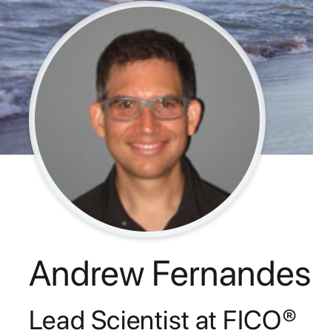


Acknowledgements
Outline Process Data ALDEx2 Example Conclusions
Andrew Fernandes
Lead Data Scientist
FICO
Jean Macklaim
Bioinformagician
DNA Genotek
Jia R. Wu
PhD student
U. Waterloo
Thom Quinn
PhD student
Deakin U.

Slide 4
The sequencing meat grinder
Outline Process Data ALDEx2 Example Conclusions
Gloor et al Front. Micro. 2017

Slide 5
The machine delivers ‘counts’
Outline Process Data ALDEx2 Example Conclusions
Example 100 random sample sets
range=1800-2200
range= 8000-12000
range=450-550
🐯
🐞
👽
Gloor et al Front. Micro. 2017

Slide 6
The machine delivers ‘counts’
Outline Process Data ALDEx2 Example Conclusions
Example 100 random sample sets
range=1800-2200
range= 8000-12000
range=450-550
🐯
🐞
👽
Gloor et al Front. Micro. 2017

Slide 7
But these ‘counts’ have a maximum sum
Outline Process Data ALDEx2 Example Conclusions
Constant sum of 1000
Constant sum operations:
Count normalization
Rarefaction
Proportion
percentage, relative abundance
Sequencing
Gloor et al Front. Micro. 2017

Slide 8
Normalization is no help at all
Outline Process Data ALDEx2 Example Conclusions
Once data are on the simplex, they cannot be removed without additional information

Slide 9
Log-ratios for CoDa
Outline Process Data ALDEx2 Example Conclusions
Count
Sequencing
Simplex
27
853
66
740
112
216
Simplex: one fewer dimensions than variables
Problems remain regardless of dimension
clr(x) = [ log(x₁/g_{X}), log(x₂/g_{X}), … log(x_{D}/g_{X}) ]
X = [ x₁, x₂, … x_{D} ], g_{X} = geometric mean of X
Aitchison 1986. Stat. Anal. Comp Data
Pawlowsky-Glahn, 2015. Mod. Anal. CoDa
Notes:
Scale dependence - hence ‘normalization’
Correlation and covariation are unreliable
Addition and subtraction are not useful operations
Subsetting and aggregating are problematic
Sparse data is an issue

Slide 10
The 0 in the room
Outline Process Data ALDEx2 Example Conclusions
0 count can be real – or a non-detect
0 count is often not 0 probability to detect the count
Sequencing instruments deliver integer scaled probabilities: ‘counts’
X=[x₁,x₂,x_{i} … x_{D}] = [p₁,p₂,p_{i} … p_{D}]α ; α=ΣX; ΣP=1
x_{i} = ( P_{i} | 𝑓_{i} )α
Fernandes, PLoS ONE 2013
Gloor, Aus J. Stat. 2016

Slide 11
ALDEx2
Outline Process Data ALDEx2 Example Conclusions
p_{i} = 0 is strong, invalid, assumption
[P_{i} > 0, P_{i} →0]
Model the expected value
Fernandes, PLoS ONE 2013
Gloor, Aus J. Stat. 2016
EBI Hinxton

Slide 12
ALDEx2: probabilistic CoDa
Outline Process Data ALDEx2 Example Conclusions
Generate posterior estimates of the data consistent with the observed data and the chosen prior(s)
Dirichlet instances
clr transform instances
Calculate test values on each instance
Correct for FDR
Report the expected value of each test for all instances
Dramatically reduces false positives with little or no loss of sensitivity for essentially any seq*omics dataset
Group 1 Group 2
Fernandes, et al. 2013. PLoS ONE
Fernandes, et al. 2014. Microbiome
Thorsen, Microbiome 2016
Notes:
Many more fragments than we can count

Slide 13
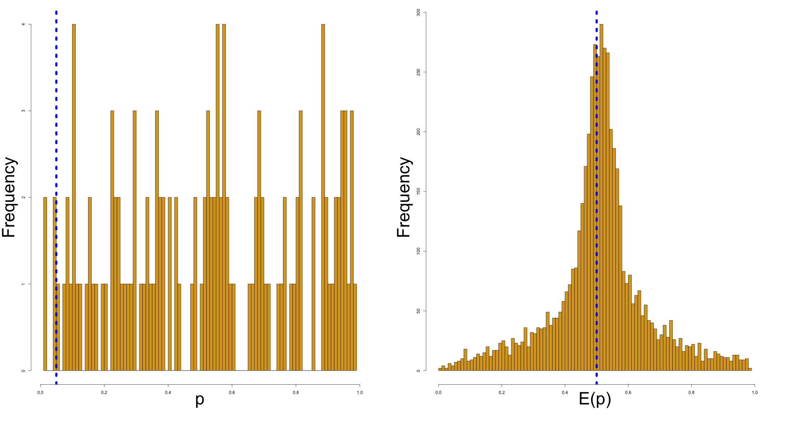
ALDEx2 Expected value
Outline Process Data ALDEx2 Example Conclusions
Features that are not robust to random sampling have an E(p) of ~0.5

Slide 14
Meta-transcriptomics of an ecosystem
Outline Process Data ALDEx2 Example Conclusions
Sequencing all the mRNA in a collection of bacteria
Information about what is being made now
Often unbalanced
Different conditions can have different taxonomic compositions
Both absolute and relative abundance of the taxa and their transcripts can change
Relative abundance does not necessarily reflect environmental reality in sequencing data

Slide 15
Bacterial vaginosis
Outline Process Data ALDEx2 Example Conclusions
Most common vaginal dysbiosis
H is predominantly Lactobacillus sp.
BV is mixed bag of anaerobes with L. iners
Marked asymmetry in composition
Asymmetrically sparse functions
Asymmetrically expressed functions
Group genes to functional level (SEED, KEGG)
If everything is different, then nothing is important
We must assume something is invariant

Slide 16
BV dataset
Outline Process Data ALDEx2 Example Conclusions
Bland-Altmann Plot
Each function is a point
Red are ‘DE’
Obviously unbalanced dataset
What assumptions do not fit?
Majority invariant?
Dispersion ~ abundance?
Counts?
Notes:
Breaks the assumptions
Note the midpoint of the dataset is off the 0 line

Slide 17
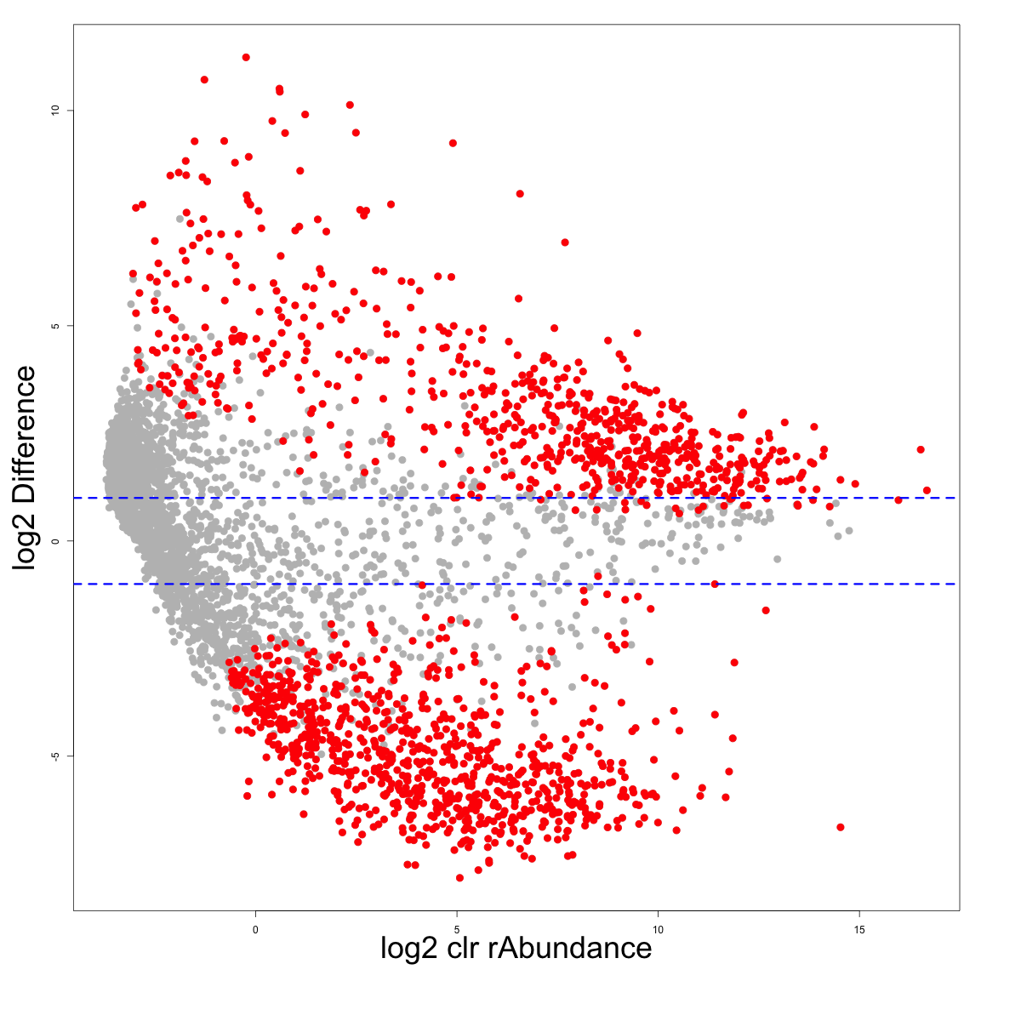
So let’s try probabilistic CoDa
Outline Process Data ALDEx2 Example Conclusions
ALDEx2

Slide 18
Strategies to center the data
Outline Process Data ALDEx2 Example Conclusions
All
One
Robust midpoint variance
Low variance, high abundance
Median

Slide 19
Properties in simulated data
Outline Process Data ALDEx2 Example Conclusions

Slide 20
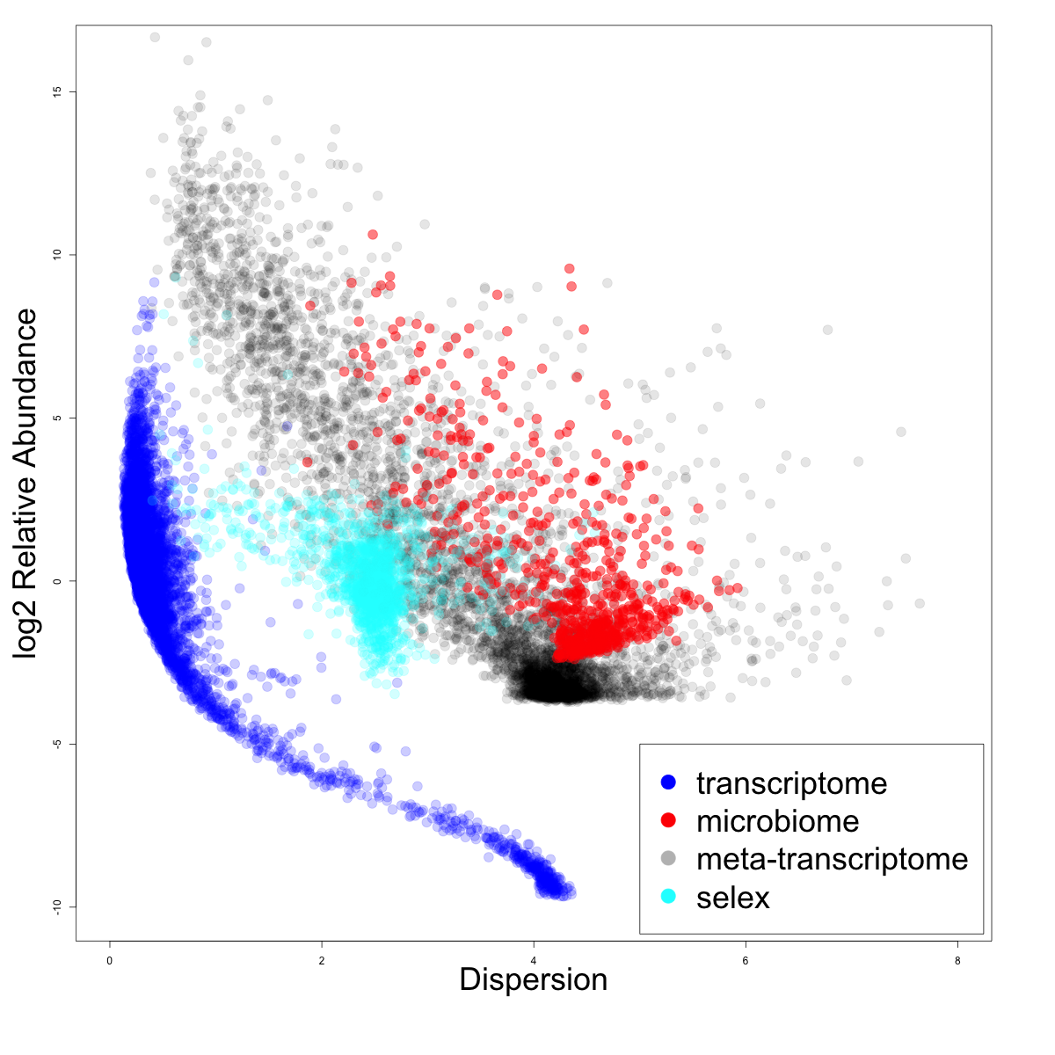
Dispersion v. rAbundance
Outline Process Data ALDEx2 Example Conclusions
iqlr high variance datasets with low reproducibility
tag-sequencing
lvha low variance datasets with high reproducibility
transcriptomes

Slide 21
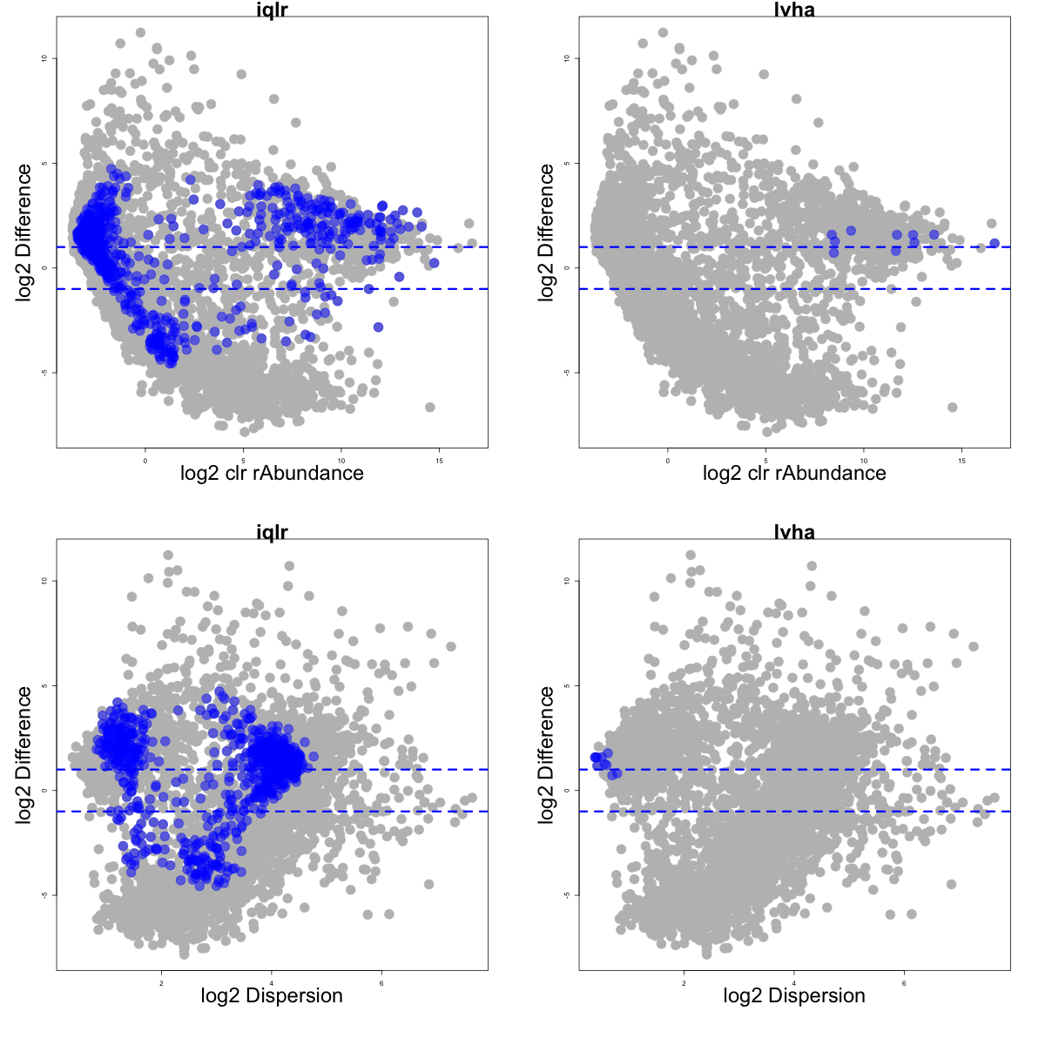
In meta-transcriptome data
Outline Process Data ALDEx2 Example Conclusions

Slide 22
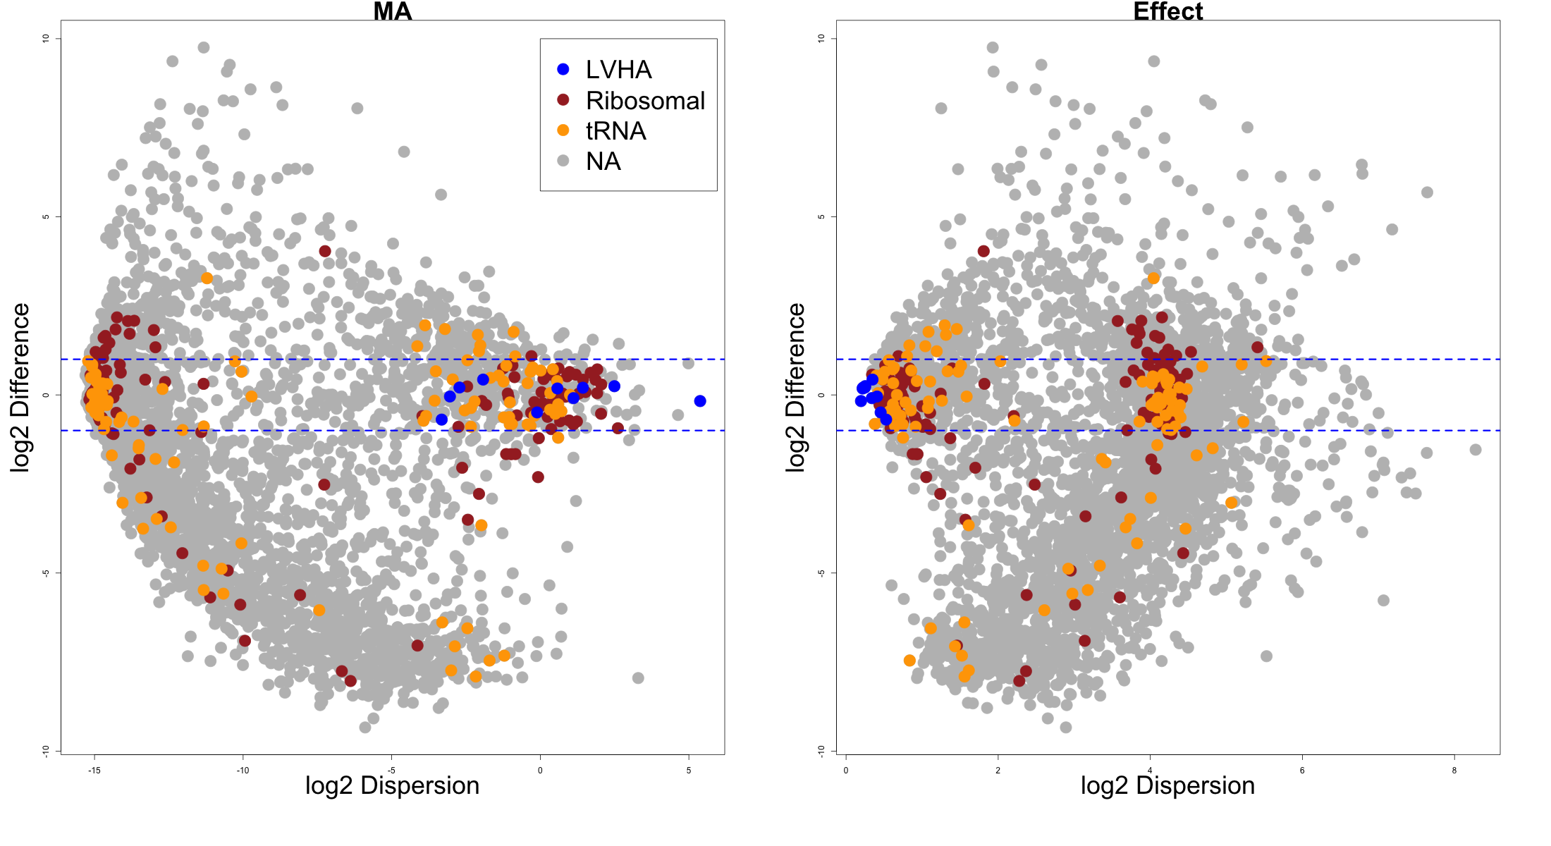
We have centered the housekeeping genes
Outline Process Data ALDEx2 Example Conclusions

Slide 23
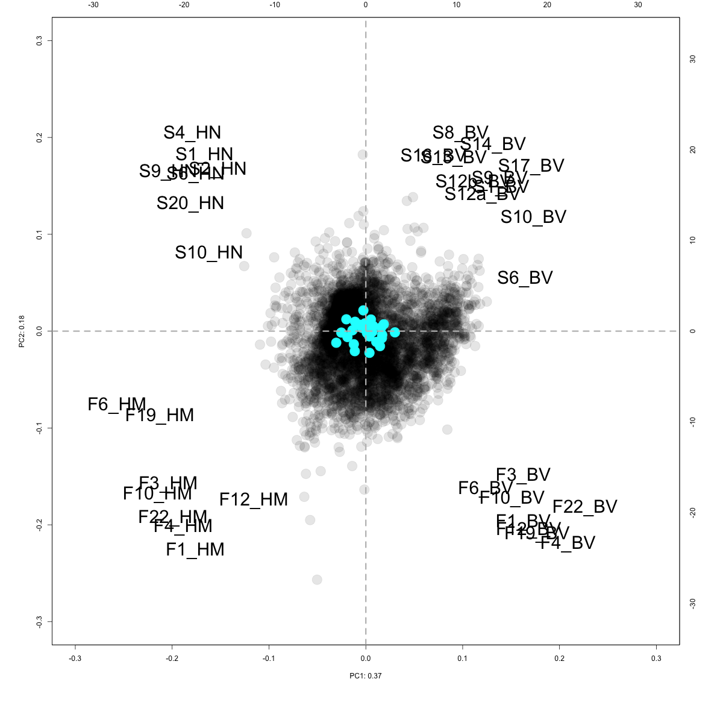
Two disparate datasets
Outline Process Data ALDEx2 Example Conclusions
Health
BV
Swabs collected in Ontario
PRJEB31833
Fluid collected in Germany
PRJEB21446
Swab
Data centred with LVHA
Fluid

Slide 24
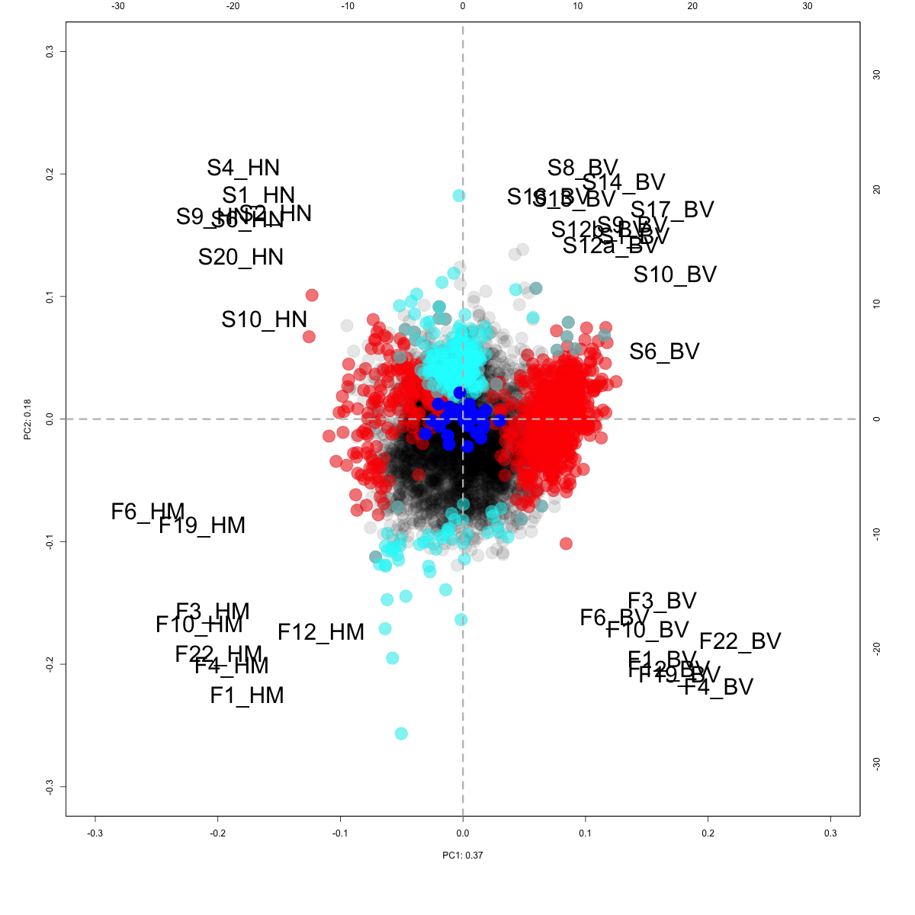
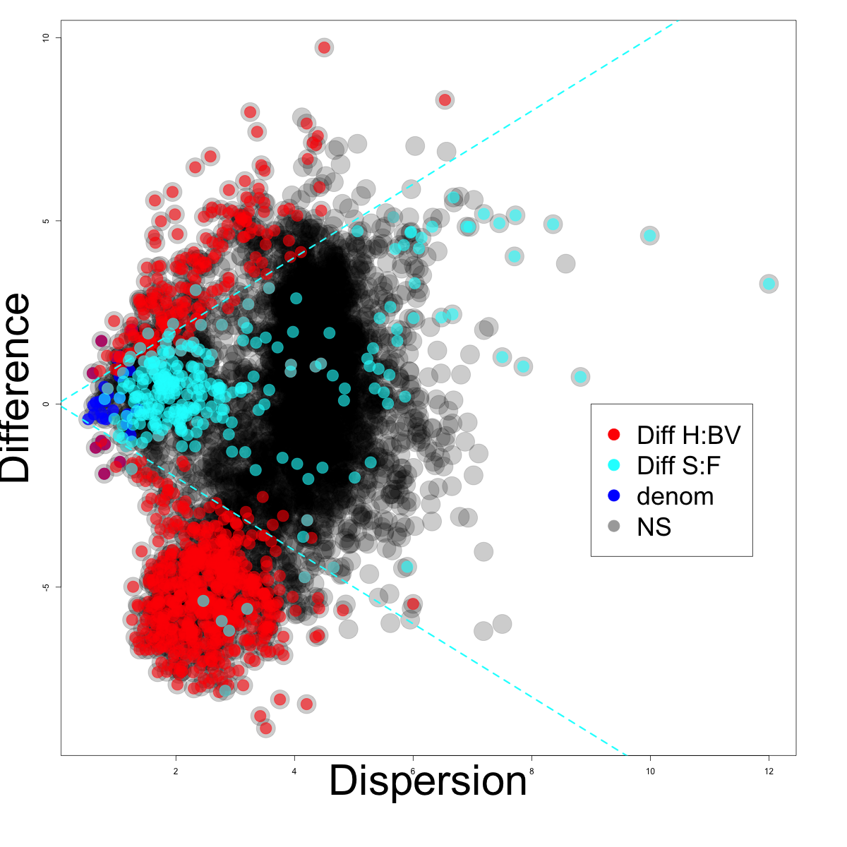
Output from aldex.glm
Outline Process Data ALDEx2 Example Conclusions
Health
BV
Health
Swab
Fluid
BV

Slide 25
Conclusions
Outline Process Data ALDEx2 Example Conclusions
Asymmetry in datasets is surprisingly common
Meta-transcriptomes are hard
Can at least get reproducible answers across datasets
Proper centering is needed to prevent non-sensical answers
Choosing the proper centering method depends on the var-abun relationship

Slide 26

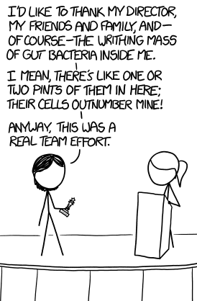


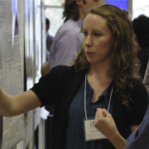




Outline Process Data ALDEx2 Example Conclusions
Andrew
Fernandes
Jean
Macklaim
Vera Pawlowsky-Glahn
Juan Jose Egozcue
Justin Silverman
philr
Tom Quinn
propr
Gregor Reid
Jeremy Burton
Jia R. Wu
Daniel Giguere

